Slide 1
HTML
Lab 14: Basic HTML

Slide 2


Welcome to HTML Class

Slide 3

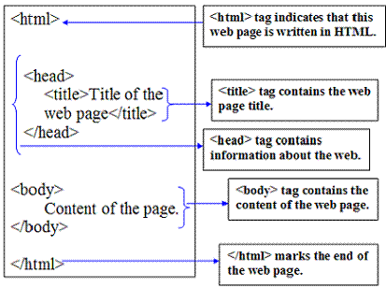
HTML Structure
Head- The head element contains title and meta data of a web document.
Body- The body element contains the information that you want to display on a web page.

Slide 4
HTML Editors
Notepad
Notepad++
TextEdit
Sublime Text

Slide 5
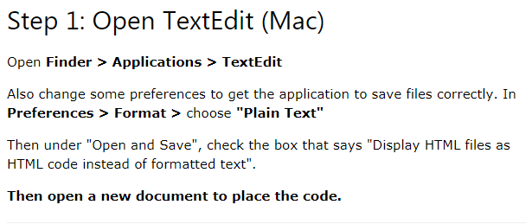
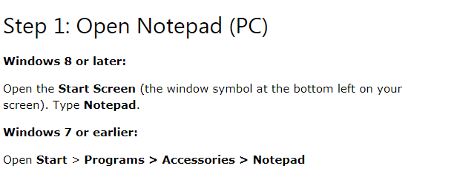
Creating web page using HTML

Slide 6
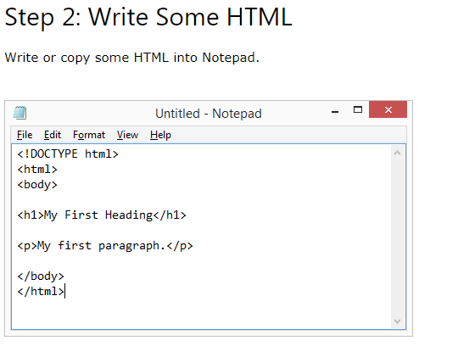
Creating web page using HTML

Slide 7
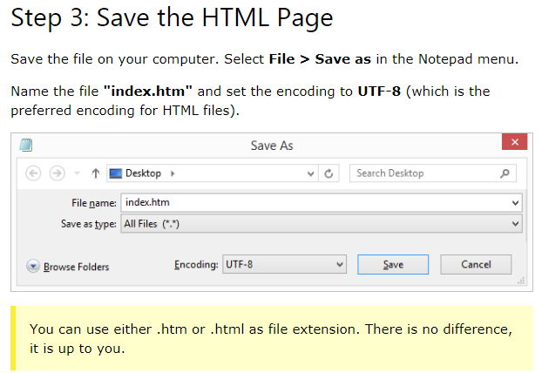
Creating web page using HTML

Slide 8
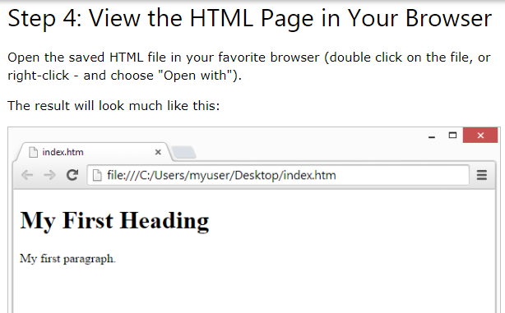
Creating web page using HTML

Slide 9
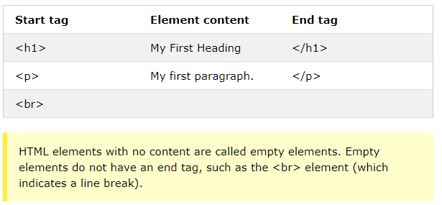
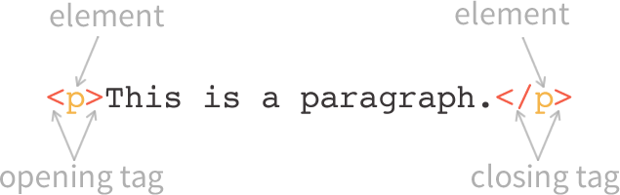
HTML Element

Slide 10

Today’s learning:
HTML Structure
HTML Editors
Creating first HTML Document
Thank You!

